Slide 1


Health Care – Drug Persistency
Exploratory Data Analysis
Jorge Alberto Jaramillo Bermúdez
^{18th} January 2024

Slide 2

Executive Summary
Summary of methodologies
Problem Understanding: Addressing the challenge of understanding factors impacting persistency to build a classification model for the given dataset.
Data Understanding: Thorough exploration of dataset characteristics, variable types, and identification of key predictors influencing persistency.
Data Cleaning and Feature Engineering: Handling missing values, outliers, and encoding categorical variables. Selecting and engineering relevant features for model development.
Model Development: Utilizing suitable classification algorithms for building a predictive model.
Model Selection: Choosing the most appropriate model based on performance metrics and problem requirements.
Model Evaluation: Assessing model performance through accuracy, precision, recall for both classes of the target variable. Additionally, reporting ROC-AUC.
Deploy the Model: If applicable, deploying the trained model in a production environment.
Explain the Challenges and Model Selection: Providing insights into challenges encountered during the process and rationale behind the chosen model, considering its suitability for the problem at hand.

Slide 3
Background
In the pharmaceutical industry, a significant challenge faced by companies is understanding the persistence of a drug as per physician prescriptions. The ability to track and analyze how patients adhere to prescription guidelines can provide valuable insights into the effectiveness and impact of pharmacological treatments.
To address this challenge, ABC Pharma, a prominent pharmaceutical company, has taken the initiative to collaborate with an analytics firm to develop an automated system for drug persistence identification. This approach aims to leverage data analytics and advanced machine learning techniques to gain a deeper and more accurate understanding of patient behavior regarding medical prescriptions.
This project not only has the potential to significantly enhance the operational efficiency of ABC Pharma but could also lead to key discoveries about adherence patterns to treatments. The successful implementation of this system could transform how the pharmaceutical industry addresses and manages drug persistence, thereby improving patient care and therapeutic outcomes.

Slide 4
ML Problem:
The objective is to gain insights into factors influencing drug persistency. The task involves constructing a classification model for the provided dataset.
Target Variable: Persistency_Flag

Slide 5

Section 1
Methodology

Slide 6
Methodology
Executive Summary
Explore and Understand the Data:
Conduct a comprehensive exploration of the dataset to grasp its structure, variable types, and potential patterns.
Identify key variables and trends related to drug persistency.
Prepare and Clean the Data:
Address missing values, outliers, and inconsistencies in the dataset.
Perform necessary data transformations and encoding to ensure compatibility for model development.
Analyze the Data and Identify Influential Features:
Utilize exploratory data analysis techniques to uncover relationships between variables.
Identify features that significantly impact drug persistency through statistical analysis.
Recommendations for Classification Model:
Based on the analysis, propose recommendations for building a classification model.
Specify the type of model (e.g., logistic regression, random forest) that is suitable for the nature of the data and the problem.
Automation of Drug Persistency Identification:
Outline the steps to automate the process of drug persistency identification using the recommended classification model.

Slide 7
Data Exploration
Dataset Overview:
Single file with 3,424 data points.
75 features/variables (including 6 derived).
Initial Statistics:
Basic statistics (mean, median, std deviation) for understanding data characteristics.
Feature Types:
Distinguish numerical and categorical features.
Missing Values:
Address and handle any missing values.
Distribution Analysis:
Explore variable distributions for range and skewness.

Slide 8
Data Exploration
Correlation Analysis:
Investigate correlations to identify potential relationships.
Derived Features:
Assess significance of derived features.
Outlier Detection:
Identify and assess potential outliers.
Visualization:
Utilize visualizations like histograms and scatter plots.
Next Steps:
Clean data by addressing missing values and outliers.
Perform targeted analyses on features influencing drug persistency.

Slide 9

Section 2
Data Visualization and Results

Slide 10
EDA with Data Visualization
Implications of High Cardinality:
High diversity in medical specialties prescribing the medication ('Ntm_Speciality').
Crucial to address this diversity for effective analysis and modeling in the context of drug persistence.
Findings:
General Practitioners (GPs):
Most frequent prescribers.
Rheumatology Specialists:
High frequency in prescribing the medication.

Slide 11
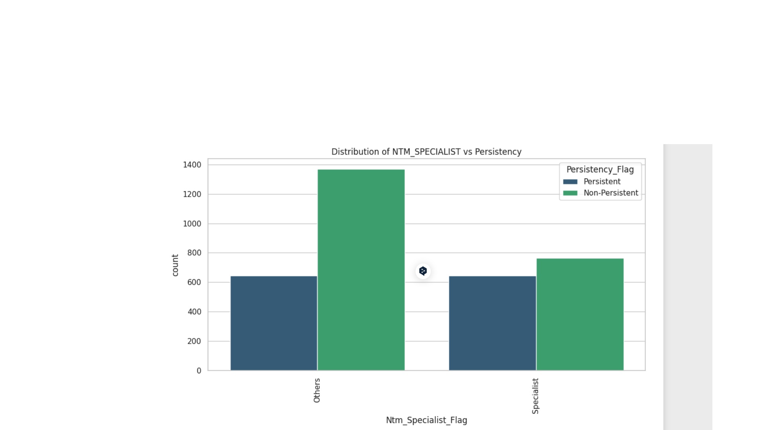
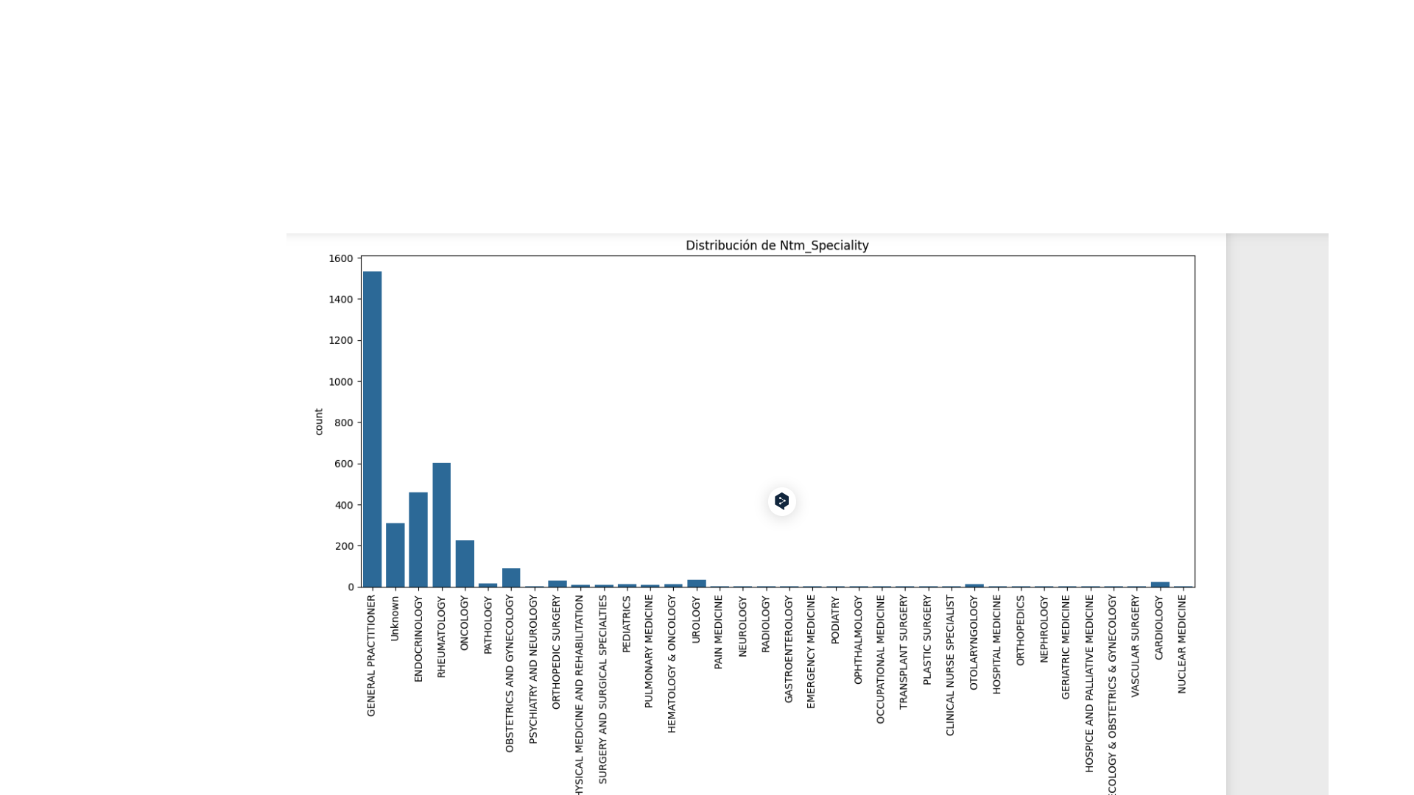
EDA with Data Visualization

Slide 12
Analysis Summary: ‘Ntm_Speciality’ Impact on Medication Encounter.
General Practitioners (GPs):
Most frequent encounters with the medication.
Rheumatology Specialists:
High frequency in encounters.
Specialize in musculoskeletal and connective tissue diseases.
Interest in T-score and bone densitometry, linked to osteoporosis and bone health.
Key Observations:
Implications:
Higher T-scores may indicate better bone health, potentially influencing medication persistence.
Clinical Relevance:
Rheumatologists' interest aligns with medication implications for musculoskeletal and bone health.
Connection to T-score and bone densitometry underscores focus on conditions like osteoporosis.

Slide 13
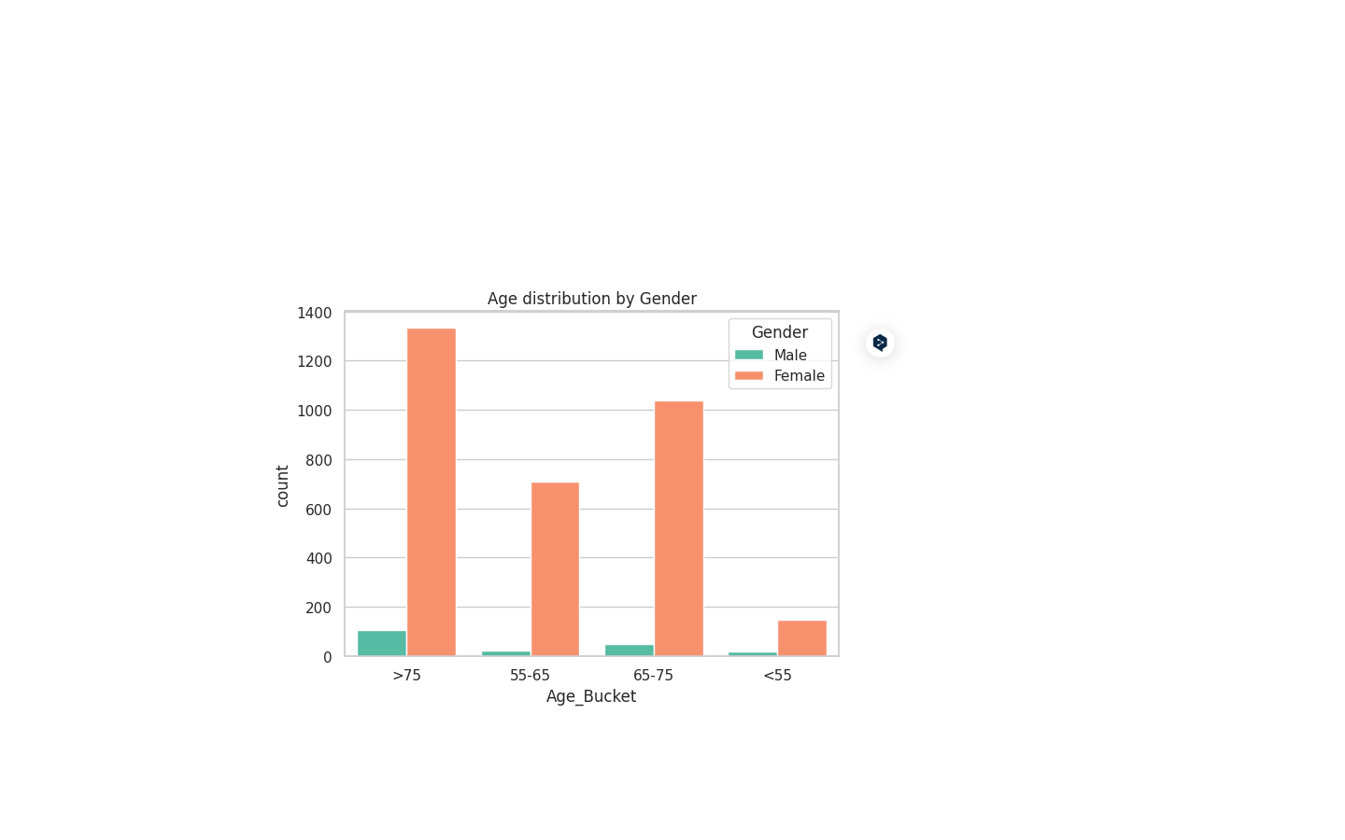
Age distribution by Gender
Age-related considerations affecting medication adherence.

Slide 14
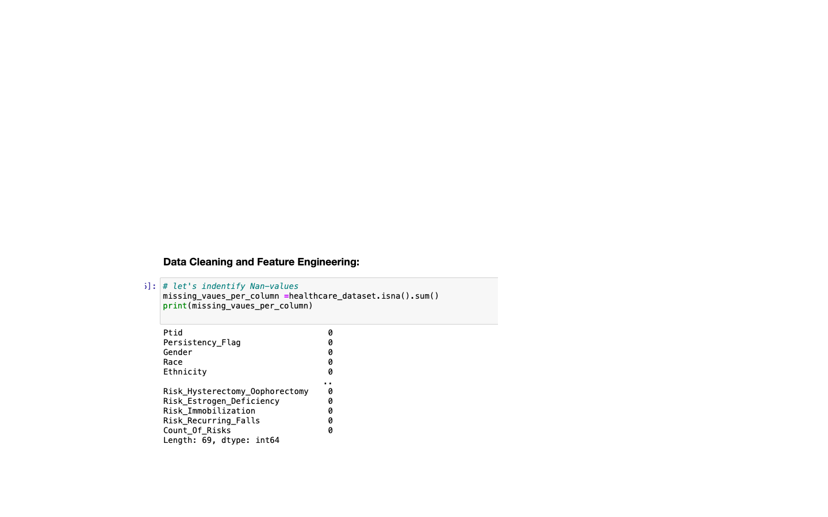
Total NaN Values:

Slide 15
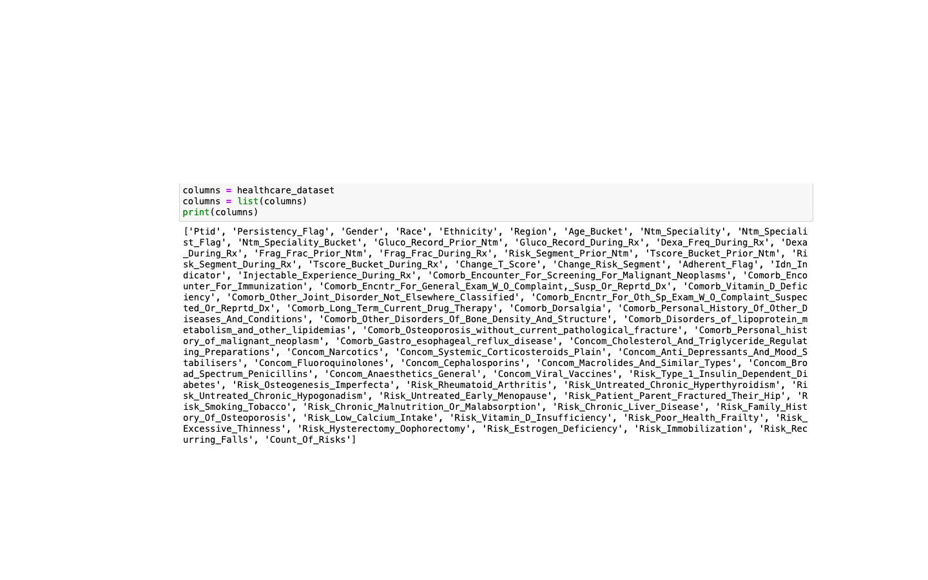
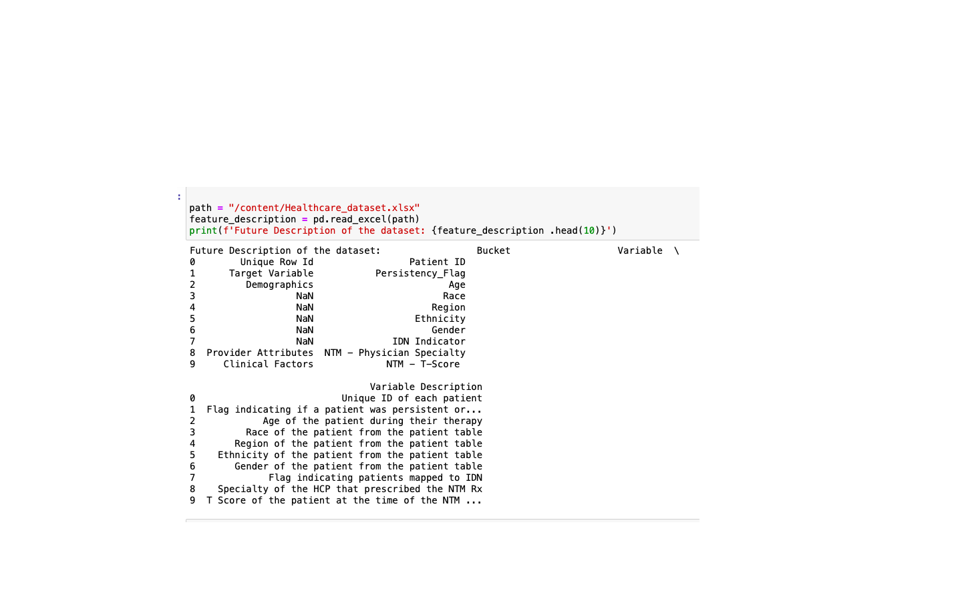
Feature Description:

Slide 16
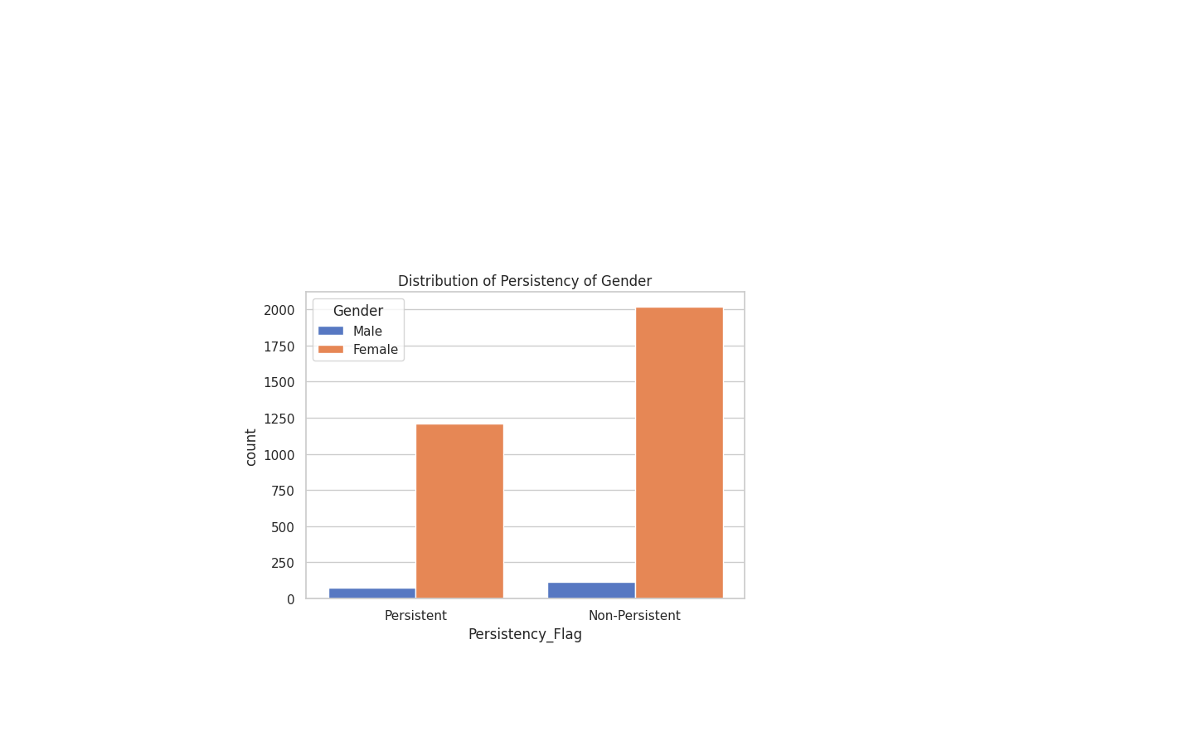
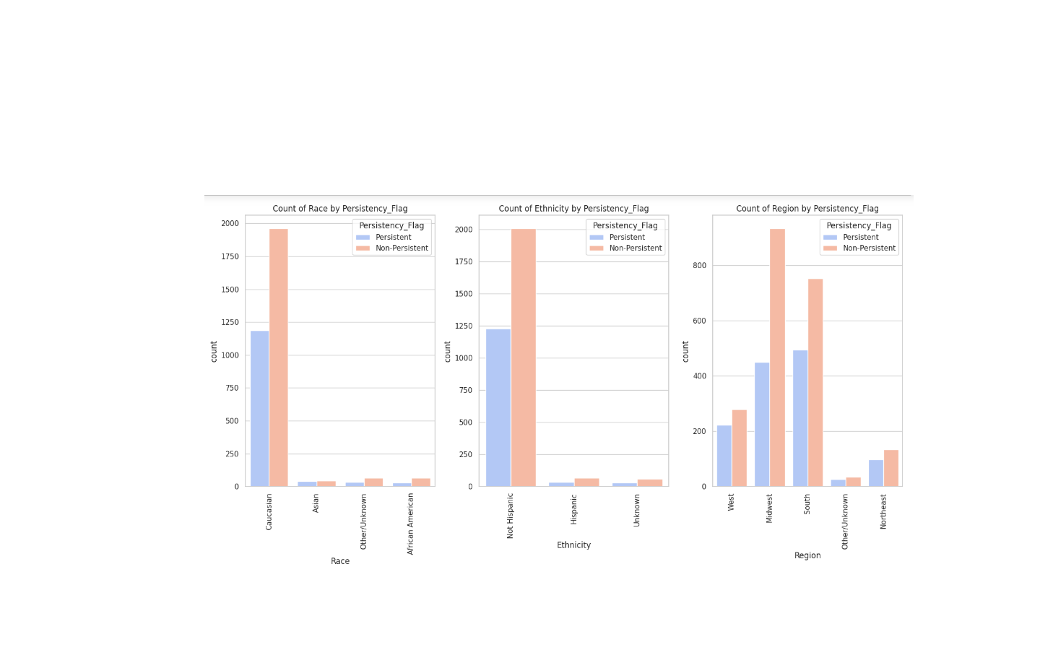
Results
In data visualization, "Persistent" patients in the ['Persistency Flag'] column are mainly older females. Over 75 years, there are about 1250 cases, followed by 1000 cases (65-75 years). In the 55-65 age group, around 700 cases, while <55 has less than 200 cases. Caucasians show the highest persistence, especially among non-Hispanic individuals. The Midwest region stands out with a notable prevalence of persistence, suggesting a higher incidence compared to other regions.

Slide 17

Section 3
Predictive Analysis
(Classification)

Slide 18
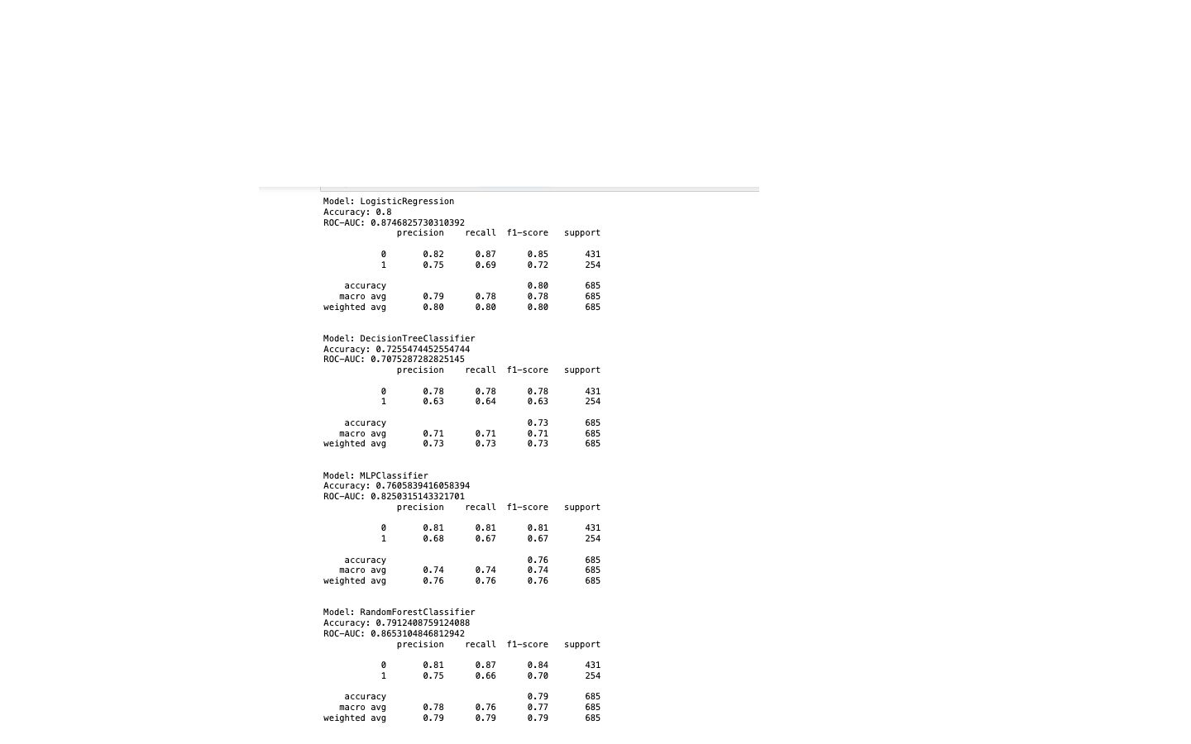
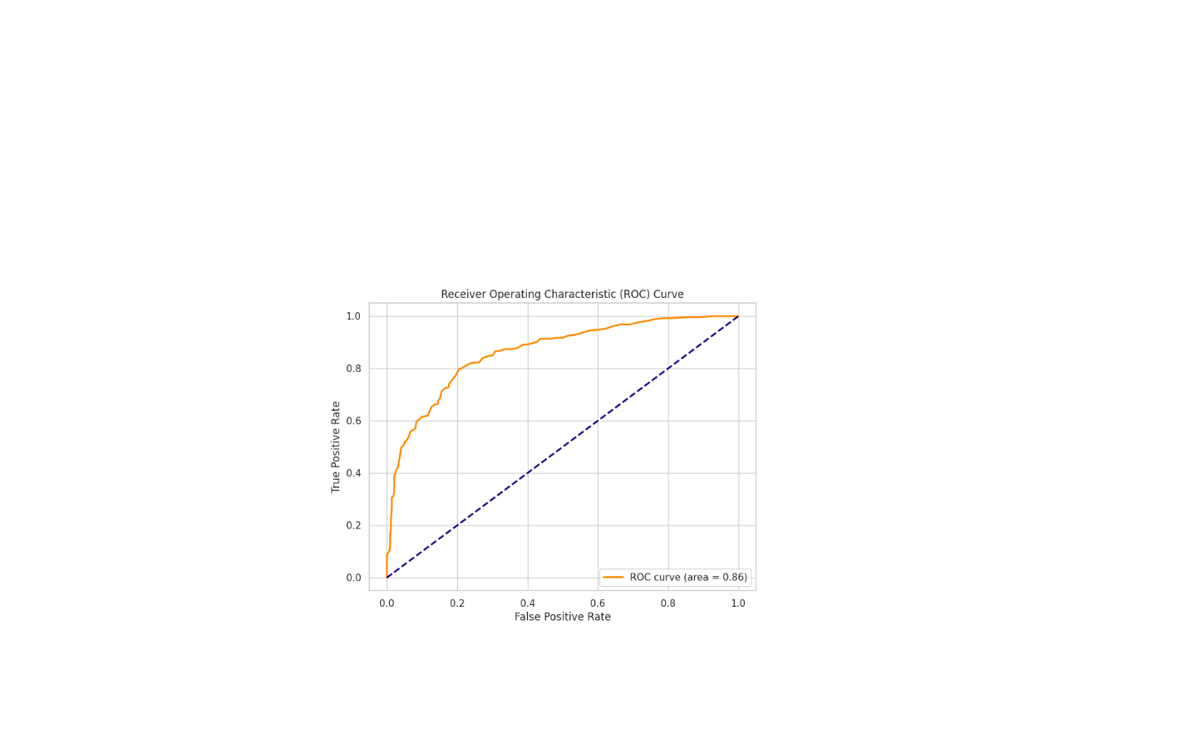
Classification Accuracy
The RandomForest Classifier emerged as the most effective model, boasting an overall accuracy of 79.27% and a ROC-AUC of 0.86.

Slide 19
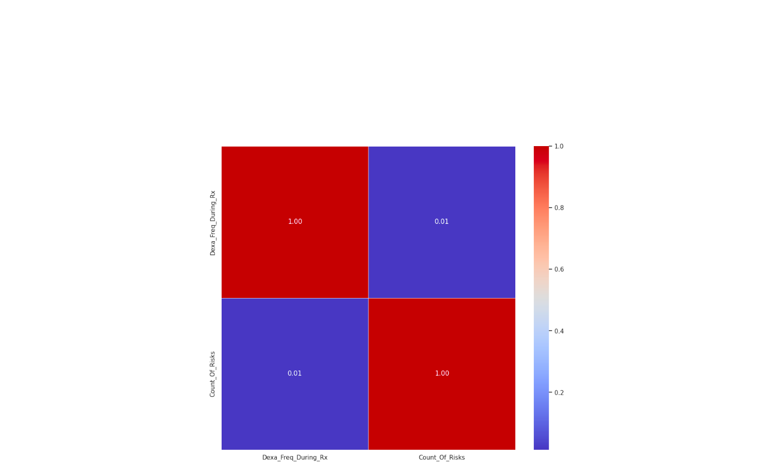
Confusion Matrix

Slide 20
Conclusions
We can conclude that:
In this analysis, the RandomForest Classifier emerged as the most effective model, boasting an overall accuracy of 79.27% and a ROC-AUC of 0.86. This model surpasses others in achieving a balance between precision and recall for both classes. Its ability to distinguish between positive and negative classes, highlighted by the area under the ROC curve, underscores its robust performance. The findings endorse the RandomForest Classifier as the preferred choice for drug persistency identification, offering a promising avenue for further refinement and application.

Slide 21

Thank you!

